Slide 1
ANAPHYLAXIS When allergies can be severe and fatal

Slide 2
Anaphylaxis: Definition and Epidemiology
Are you ready for anaphylaxis?

Slide 3
Definition of Anaphylaxis
Anaphylaxis is a serious reaction that is rapid in onset and may cause death¹
Anaphylaxis is a systemic reaction resulting from the sudden release of multiple mediators (not just histamine) from mast cells and basophils
Anaphylaxis is defined by a wide spectrum of symptoms and their severity
Although “shock” may occur during anaphylaxis, it most often occurs in the absence of shock, hypoxia, or collapse
Quick recognition of anaphylaxis is critical for successful treatment
NIAID, National Institute of Allergy and Infectious Diseases; FAAN, Food and Allergy Anaphylaxis Network.
1. Sampson HA, et al. J Allergy Clin Immunol. 2006;117:391-397.
Notes:
3
3
Important points:
“Anaphylaxis” encompasses several different conditions, such as anaphylaxis to food, stinging insects, medications, etc. These types of anaphylaxis have different natural history and clinical implications. While some aspects are similar (eg, most of emergency management), others are not.

Slide 4
Anaphylaxis
Anaphylaxis is a hypersensitivity reaction to foreign substances such as foods, medications, and insect bites or stings. Anaphylaxis is a serious, life-threatening generalized or systemic hypersensitivity reaction and a serious allergic reaction that is rapid in onset and can be fatal. Symptoms may be throat swelling, itchy rash, and low blood pressure.

Slide 5
Prevalence and State of Anaphylaxis Readiness
Anaphylaxis diagnosis is frequently missed or anaphylaxis is incorrectly diagnosed
Recent national survey data:
Anaphylaxis occurs in at least 1 in 50 up to 1 in 20 adults
Demonstrates many patients are not adequately equipped to deal with future episodes
There is a need for public health initiatives to improve anaphylaxis recognition and treatment
Wood RA, et al. J Allergy Clin Immunol. 2014;133:461-467.
Lieberman P, et al. Ann Allergy Asthma Immunol. 2006;97(5):596-602.
Simons FER, et al. J Allergy Clin Immunol. 2008;122:1166-1168.

Slide 6
Anaphylaxis is a global public health concern
The rate of anaphylaxis occurrence seems to be increasing with geographic variations.
Data on the prevalence of anaphylaxis in the general population is limited.
However, the recent survey in the United States indicates that the prevalence of anaphylaxis in the general population is at least 1.6% and probably higher.
In contrast, a European study indicated that an estimated 0.3% (95% CI 0.1-0.5) of the population experience anaphylaxis at some point of time in their lives.

Slide 7
Classification of Human Anaphylaxis
Human Anaphylaxis
Immunologic
Non-Immunologic
Idiopathic
IgE, FcεRI
Non-IgE, Non-FcεRI
Other
Physical
Foods, venoms, latex, drugs
Dextran, OSCS, contaminants
in heparin, transfusion reactions
Radiocontrast media, aspirin, opioids, NSAIDs
Exercise, cold
ANAPHYLACTOID
IgE, immunoglobulin E;
FcɛRI, high-affinity IgE receptor;
OSCS, oversulfated chondroitin sulfate;
NSAIDs, nonsteroidal anti-inflammatory drug.
Simons FER, et al. J Allergy Clin Immunol. 2010;125:S161-S181.
Notes:
7
Non-immunologic mechanisms
Physical factors (eg, exercise, cold and heat)
Ethanol
Medications (eg, NSAIDs, opioids, neuromuscular blocking agents)
Radiocontrast media
Idiopathic anaphylaxis
Consider the possibility of:
Hidden or previously unrecognized allergens
Mastocytosis/clonal mast cell disorder
Immunologic mechanisms
IgE dependent
Foods such as peanut, tree nut, shellfish, fish, milk, egg, soy, sesame
Venoms, such as insect stings
Natural rubber latex
Seminal fluid
Biologic therapies (eg, monoclonal antibodies)
Immunotherapy
Medications such as penicillin
IgE independent
Dextran, such as high-molecular-weight iron dextran
Contaminants in heparin
Blood transfusions

Slide 9
Causes of anaphylaxis
The relative importance of specific anaphylaxis triggers in different age groups appears to be universal.
Foods are the most common trigger in children, teens and young adults.
Insect stings and medications are relatively common triggers in middle-aged and elderly adults.

Slide 10
When anaphylaxis can become worse or fatal
Potential associated factors that can cause more severe forms and fatal allergies include:
age
physiologic state (such as pregnancy)
concomitant diseases
poorly controlled asthma
cardiovascular disease
concurrent use of medications
Beta-adrenergic blockers
ACE inhibitors
amplifying co-factors
Exercise
non-steroidal antiinflammatory drugs
Infections
emotional stress
perimenstrual status

Slide 12
Patient Reported Causes of Anaphylaxis
*Reported reactions were categorized as those involving ≥1 system.
**Confirmed reactions were categorized as those involving ≥2 systems with respiratory and/or cardiovascular symptoms or those leading to loss of consciousness, even if only that single system was involved.
Wood RA, et al. JACI. 2014;133:461-7

Slide 13
In Children, Most Cases Are Food Related and Males Predominate
N=46 cases (28 male,
18 female)
Median age at first episode:
5.8 years
Only small proportion idiopathic
Number of Cases (1994-1996)
25
20
15
10
5
0
Number of Children
Food
Drug
Exercise
Idiopathic
Hymenoptera
Other
Cianferoni A, et al. Ann Allergy Asthma Immunol. 2004;92:464-468.
Notes:
13

Slide 14
Food Allergy Increasing in the US
Food allergy prevalence in children as high as 8.0%¹
39.7% had a history of severe reactions
30.4% had multiple food allergies
Prevalence was highest for peanut followed by
milk and shellfish
8 major foods are responsible for >90% of serious allergic reactions in the US (fish, shellfish, peanut,
tree nuts, milk, egg, wheat, soy)²
1. Gupta, et al. Pediatrics. 2011;128:e9-e17.
2. Boyce JA, et al. J Allergy Clin Immunol. 2010;126:S1-S58.
Notes:
The goal of this study by Gupta et al was to better estimate the prevalence and severity of childhood food allergy in the United States.
This was a randomized, cross-sectional survey was administered electronically to a representative sample of US households with children from June 2009 to February 2010. Eligible participants included adults (aged 18 years or older). Data were adjusted using both base and post-stratification weights to account for potential biases from sampling design and nonresponse. Data were analyzed as weighted proportions to estimate prevalence and severity of food allergy. Multiple logistic regression models were constructed to identify characteristics significantly associated with outcomes.
Data were collected for 40 104 children; incomplete responses for 1624 children were excluded, which yielded a final sample of 38 480. Food allergy prevalence was 8.0% (95% confidence interval [CI]: 7.6-8.3). Among children with food allergy, 38.7% had a history of severe reactions, and 30.4% had multiple food allergies. Prevalence according to allergen among food-allergic children was highest for peanut (25.2% [95% CI: 23.3-27.1]), followed by milk (21.1% [95% CI: 19.4-22.8]) and shellfish (17.2% [95% CI: 15.6-18.9]). Odds of food allergy were significantly associated with race, age, income, and geographic region. Disparities in food allergy diagnosis according to race and income were observed.
Findings suggest that the prevalence and severity of childhood food allergy is greater than previously reported. Data suggest that disparities exist in the clinical diagnosis of disease.

Slide 15
In Adults, Most Cases Are Idiopathic and Females Predominate
N=601 cases
62% of cases were female
37% were atopic by history confirmed with skin test

Slide 16
Patient Factors That Increase Risk of an Event or Potentiates It Severity
History of previous anaphylactic reaction
Atopy
Asthma
Age
Adolescents and young adults: risk-taking behaviors
Elderly: comorbidities and medications
Cardiovascular disease
Medications (β-blockers, ACE inhibitors, ARBs, tricyclics, MAO inhibitors)
Mast cell activating disorders
ACE, angiotensin-converting enzyme; ARB, angiotensin receptor blocker; MAO, monoamine oxidase.
Simons FER, et al. J Allergy Clin Immunol. 2010;125:S161-S181.

Slide 17
Anaphylaxis Signs and Symptoms

Slide 18
Frequency and Occurrence of Signs and Symptoms of Anaphylaxis
Signs and Symptoms | Percent*
Cutaneous Urticaria and angioedema Flushing Pruritus without rash | 85-90 45-55 2-5
Respiratory Dyspnea, wheeze Upper airway angioedema Rhinitis | 45-50 50-60 15-20
Hypotension, dizziness, syncope, diaphoresis | 30-35
Abdominal Nausea, vomiting, diarrhea, cramping pain | 25-30
Miscellaneous Headache Substernal pain Seizure Angor animi | 5-8 4-6 1-2 ––
*Percentages are approximations.
Lieberman P, et al. J Allergy Clin Immunol. 2010;126:477-480.
Notes:
18

Slide 19
Patient Reported Symptoms of Anaphylaxis
Symptoms Reported by Patients with Anaphylaxis in their
Most Recent Reaction (n=344)
Patient survey notes:
*Applies only to children age 6 and younger (n=10).
†Loss of consciousness was only queried in the patient survey.
Wood RA, et al. J Allergy Clin Immunol. 2014;133:461-467.

Slide 20
Patient-Reported Organ System Involvement in Anaphylaxis
Organ System Involvement Reported by Patients with Anaphylaxis in Most Recent Reaction (N=344)
Patient Survey (n=344):
Wood RA, et al. J Allergy Clin Immunol. 2014;133:461-467.

Slide 21
Anaphylaxis Diagnosis

Slide 22
Clinical Criteria for Diagnosing Anaphylaxis
Acute onset of an illness
(minutes to several hours)
with involvement of the skin, mucosal tissue, or both
OR
≥2 of the following that
occur rapidly after
exposure to a likely
allergen (minutes to
several hours):
OR
Reduced BP after
exposure to known
allergen (minutes
to several hours):
AND AT LEAST 1
OF THE FOLLOWING
Involvement of the
skin-mucosal tissue (eg, generalized hives,
itch-flush, swollen
lips-tongue-uvula)
b. Respiratory compromise
c. Reduced BP or associated symptoms
d. Persistent gastrointestinal symptoms (eg, crampy abdominal pain, vomiting)
Infants and children:
low SBP* (age specific) or >30% decrease in SBP
b. Adults: SBP of <90 mm Hg or >30% decrease from that person’s baseline
Respiratory
compromise
(eg, dyspnea,
wheeze-
bronchospasm)
Reduced BP
or associated
symptoms
of end-organ
dysfunction
*Low SBP for children is defined as <70 mm Hg from 1 month to 1 year, <70 mm Hg plus (2x age) from 1 to 10 years, and <90 mm Hg from 11 to 17 years.
Sampson HA, et al. Ann Emerg Med. 2006;47:373-380.
BP, blood pressure; SBP, systolic blood pressure.

Slide 23
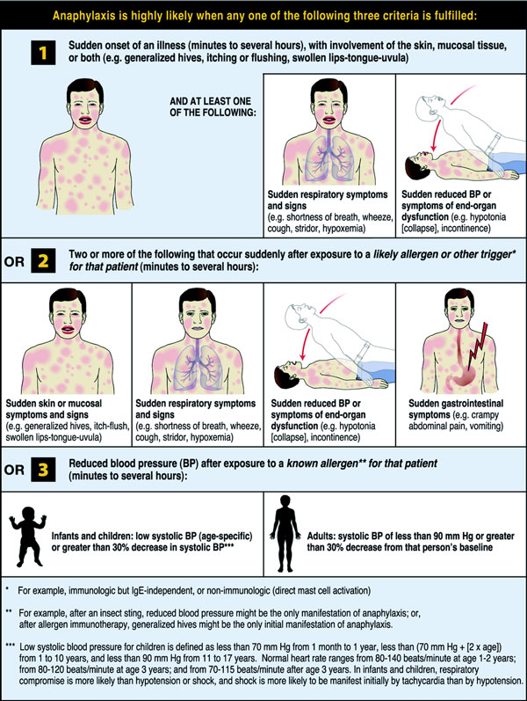

Slide 24
Case Study #1: Eric,7-year-old Male

Slide 25
Case Study #1: Eric 7-year-old Male
Patient presents to pediatrician office for follow-up following confirmed anaphylaxis
2 months ago, developed mild hives after eating walnut brownie
Was told by pediatrician to take antihistamine and call if reaction worsened
Recent reaction followed eating pre-packaged pie from grocery store
Symptoms included:
Hives, swelling of tongue, GI pain, vomiting
Mother tried to manage with antihistamine, but reaction worsened
Went to urgent care center where she was given another antihistamine and monitored him to see if reaction worsened
Reaction subsided after 3 hours
Patient never received epinephrine
Mother later checked food label, which included “processed in a facility that also processes nuts”

Slide 26
Case Study #1: History
Healthy 7-year-old male
Physical exam unremarkable
Allergic history:
No known allergies
Developed hives after eating a walnut brownie 2 months ago
Resolved with antihistamines
Last week, developed hives, gastrointestinal upset, vomiting, and mild swelling of the tongue after eating blueberry pie
Not responsive to oral antihistamine initially
Resolved on own after 3 hours

Slide 27
A Higher Proportion of Subsequent Reactions Are Severe and Require Epinephrine
First reaction
Second reaction
Third reaction
60
50
40
30
20
10
0
*
*
*
*
Percent (%)
*
Severe
Epinephrine
Severe
Epinephrine
Peanuts
Tree Nuts
*Indicates a reaction significantly greater than prior reaction (P<.05).
Data from the first 5,149 patients in a voluntary registry for peanut and tree nut allergy.
Sicherer SH, et al. J Allergy Clin Immunol. 2001;108:128-132.
Notes:
27
27
27
The course of an anaphylaxis episode and the window of opportunity for successful epinephrine treatment cannot be predicted with certainty and may differ from one person to another, and from one episode to another in the same person.
Individuals in the Food Allergy and Anaphylaxis Network’s voluntary registry, or caregivers of children in the registry, answered a structured questionnaire about allergic reactions to peanut and tree nut.
Registrants were primarily children (89% of registrants were younger than 18 years of age; the median age was 5 years).
In comparison with the initial reactions, a higher proportion of subsequent reactions were severe and were treated with epinephrine (first reaction vs third reaction).

Slide 28
Patient Avoidance of Packaged Foods Due to Warning Label
How often would you purchase a product (intended for a person who has food allergies) if the label contained the following?
% of Responders
Food Allergy Research and Education Survey on Thresholds. Available at: www.foodallergy.net. Accessed May 15, 2014.

Slide 29
Case Study #1: Clinical Questions
Was Eric’s reaction anaphylaxis?
How would you identify the allergen?
What advice do you give to Sarah and Eric?
How do you treat Eric?
Allergen avoidance
Provision of an auto-injector? How many?
Patient education
Emergency action plan

Slide 30
Anaphylaxis Treatment

Slide 31
Guidelines Clearly Position Epinephrine as First-line Therapy
WAO Anaphylaxis Guidelines
Anaphylaxis Practice Parameter
NIAID-Sponsored Expert Panel on Food Allergy
ICON; Food Allergy
Epinephrine has a primary role in the management of anaphylaxis
Prompt IM injection of epinephrine, the first-line medication, should not be delayed by taking the time to draw up and administer adjunctive medications, such as antihistamines and glucocorticoids
Epinephrine is the drug of choice for the treatment of anaphylaxis
The appropriate dose of epinephrine should be given promptly at the onset of apparent anaphylaxis
Epinephrine is the first-line treatment in all cases of anaphylaxis
When there is suboptimal response to the initial dose of epinephrine, dosing remains first-line therapy over adjunctive treatments
Upon discharge,
2 doses by
auto-injector should be prescribed
Epinephrine is the first-line treatment for anaphylaxis
Upon discharge,
2 doses by
auto-injector should be prescribed
Patients must be educated on when and how to use the epinephrine
auto-injector device
WAO, World Allergy Organization; ICON, international consensus on.
Burks AW, et al. J Allergy Clin Immunol. 2012;129:906-920; Simons FER, et al. WAO Journal. 2011;4:13-37; Boyce JA, et al. J Allergy Clin Immunol. 2010;126:S1-S58; Lieberman P, et al. J Allergy Clin Immunol. 2010;126:477-480.

Slide 32
Acute Management When Anaphylaxis Is Suspected
Administer IM epinephrine quickly
Repeat every 5 to 10 minutes if necessary
Place patient in supine position with legs elevated
Consider oxygen for all patients
Treatment in order of importance is: epinephrine, patient position, oxygen, IV fluids, nebulized therapy, vasopressors, antihistamines, corticosteroids, and other agents
Evaluate hypotension and need for IV fluids
Individualize observation
IM, intramuscular; IV, intravenous.
Lieberman P, et al. J Allergy Clin Immunol. 2010;126:477-480.
Notes:
Important point:
Please discuss proper dilution and dosing for anaphylaxis vs resuscitation dosing for AMI.
32

Slide 33
Administer Epinephrine IMMEDIATELY!!!
Failure to administer epinephrine promptly is the most important factor contributing to death in patients with anaphylaxis
The vasopressive effects of epinephrine, along with its effects in preventing and relieving laryngeal edema and bronchoconstriction, may be life saving
Sampson HA, et al. N Engl J Med. 1992;327:380-384.

Slide 34
IM Epinephrine Dosing
Epinephrine dosing:
IM epinephrine (to lateral aspect of thigh) from 1:1,000 dilution (1 mg/mL) injected as 0.2 to 0.5 mL (0.01 mg/kg in children, maximum dose 0.3 mg)
Lieberman P, et al. J Allergy Clin Immunol. 2010;126:477-480.
Notes:
34
34

Slide 35
Epinephrine is Underutilized in EDs
Emergency Treatment Used for Anaphylaxis by Cause (n=2114 severe anaphylaxis cases in Germany, Austria, and Switzerland)
80%
70%
60%
50%
40%
30%
20%
10%
0%
Insect sting
Food
Drugs
Percentage of Patients
Receiving Treatment
Adrenaline Antihistamine Corticoid Beta-2-Agonist Oxygen Fluid
Grabenhenrich L, et al. PLoS One. 2012;7(5):e35778.

Slide 36
Why Epinephrine?

Slide 37
Fatal Events Can Rapidly Progress
Failure to administer epinephrine promptly is the most important factor contributing to death in children and adolescents with anaphylaxis¹
Median time to respiratory or cardiac arrest was²:
5 minutes for iatrogenic reactions
15 minutes for venom
30 minutes for foods
1. Sampson HA, et al. N Engl J Med. 1992;327:380-384.
2. Pumphrey RS. Clin Exp Allergy. 2000;30(8):1144-1150.

Slide 38
Action of Epinephrine
Epinephrine
α₁-adrenergic
receptor
α₂-adrenergic
receptor
β₁-adrenergic
receptor
β₂-adrenergic
receptor
↑ Vasoconstriction
↑ Peripheral vascular resistance
↑ Heart rate
↓ Mucosal edema
↓ Insulin release
↑ Inotropy
↑ Chronotropy
↑ Bronchodilation
↑ Vasodilation
↑ Glycogenolysis
↓ Mediator release
Simons KJ, Simons FER. Curr Opin Allergy Clin Immunol. 2010;10:354-361.
Notes:
38

Slide 39
IM Epinephrine: Onset of Effect
160
140
120
100
80
60
40
20
0
Maximum pharmacodynamic effect occurs before 10 minutes
Systolic pressure
Diastolic pressure
Heart rate
Blood Pressure (mm Hg)/
Heart Rate (bpm)
Systolic pressure
Diastolic pressure
Heart rate
10
20
30
40
50
60
Time (min)
Adapted from Simons FER, et al. J Allergy Clin Immunol. 1998;101:33-37.
Notes:
Patients were injected 0.01 ml/kg epinephrine solution (maximum 0.3 ml [0.3 mg]) subcutaneously, or 0.3 mg epinephrine intramuscularly from an autoinjector.
In nine children who received epinephrine subcutaneously, the mean maximum plasma epinephrine concentration (+/- SEM) was 1802 +/- 214 pg/ml, achieved at a mean time of 34 +/- 14 minutes (range, 5 to 120 minutes). Only two of the nine children achieved maximum plasma concentrations by 5 minutes.
[Shown in graph] In eight children who received epinephrine intramuscularly, the mean maximum plasma concentration was 2136 +/- 351 pg/ml, achieved at a mean time of 8 +/- 2 minutes, which was significantly faster than the mean time at which maximum plasma concentrations were achieved after subcutaneous epinephrine injection (p< 0.05). Six of the eight children achieved maximum plasma concentrations by 5 minutes.

Slide 40
Absorption of Epinephrine Faster With IM vs SC Injection
34 ±14 min
SC epinephrine
50
45
IM epinephrine
40
P<.05
35
30
Minutes
25
20
15
8 ± 2 min
10
5
0
Time to C_{max} After Injection (minutes)
SC, subcutaneous.
Adapted from Simons FER, et al. J Allergy Clin Immunol. 2004;113:837-844.
Notes:
40
40
40
Absorption of epinephrine is faster after intramuscular injection than after subcutaneous injection. In a prospective, randomized, blinded study in children, the tmax was 8 ± 2minutes after injection of epinephrine 0.3mg from an EpiPen intramuscularly in the vastus lateralis. In contrast, the time to tmax was 34 ± 14 minutes (range, 5 to 120) after injection of epinephrine 0.01 mg/kg subcutaneously in the deltoid region.

Slide 41
Case Study #1: Treatment
Epinephrine auto-injectors (2)
Patient education or avoidance measures
Emergency Action Plan
Referral to an allergist for skin tests
Arrange follow-up to discuss results of skin-prick tests and avoidance strategies

Slide 42
Why an Auto-injector?

Slide 43
Difficulty Drawing Epinephrine From an Ampule in the Real World
260
240
220
200
180
160
140
120
100
80
60
40
20
0
P<.05 vs
all control groups
Time (seconds)
Parents
Physicians
General Duty Nurses
ED
Nurses
Controls
Simons FER, et al. J Allergy Clin Immunol. 2001;108:1040-1044.
Notes:
43
Individuals with no medical training have difficulty drawing up epinephrine from an ampule.
In a prospective study, 18 parents, 18 resident physicians, 18 general duty nurses, and 18 emergency department nurses drew up an infant epinephrine dose from a 1-mL ampule.
The parents required a mean time of 142 ± 13 seconds (range, 83-248), significantly longer (P<0.05) than the control groups.
Moreover, the epinephrine content of the parents’ doses ranged 40-fold, and their speed and accuracy did not correlate.

Slide 44
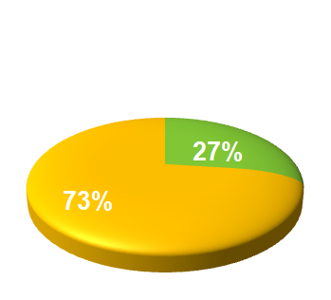
Epinephrine Auto-injectors are Under-prescribed
Venom anaphylaxis patients prescribed an AAI at discharge from Emergency Department
Only one quarter of patients who had suffered a venom anaphylaxis were prescribed an AAI on discharge!
Yes
No
Clarck, et al. J Allergy Clin Immunol. 2005;116(3):643-649.

Slide 45
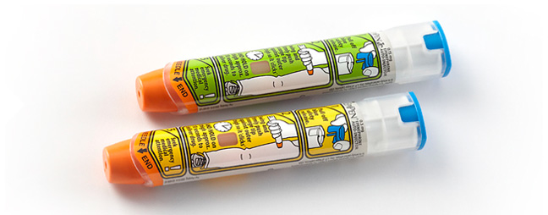
Available Auto-injectors: EpiPen
Available at: http://www.epipen.com/pdf/EPI_HowtoTearSheet.pdf.
Notes:
45

Slide 46
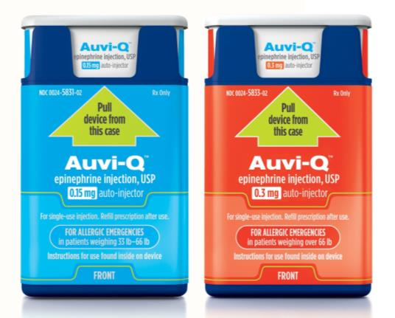
Available Auto-injectors: Auvi-Q
Available at: http://www.auvi-q.com/.
Notes:
46

Slide 47
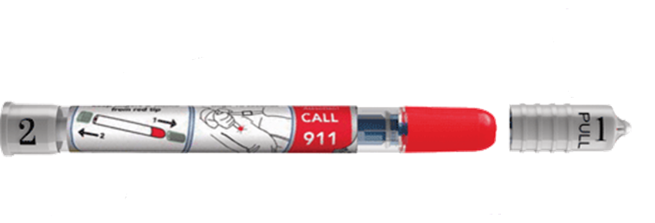
Available Auto-injectors: Adrenaclick
Available at: http://www.adrenaclick.com/about-adrenaclick/.
Notes:
47

Slide 48
The Needle Is Not Too Short
The pressure applied to trigger AND...
The spring loaded device function to propel epinephrine beyond the length of the needle
Needle
length
Epinephrine
penetration
Skin
Subcutaneous fat
Muscle
1.43 cm
2.69 cm

Slide 49
Why Not an Antihistamine or Corticosteroid?

Slide 50
Why Not an Antihistamine?
Anaphylaxis is not mediated by histamine alone*
Antihistamines antagonize only histamine and have slower onset of action than epinephrine
Guidelines state that antihistamines are second line to and should not be administered in lieu of epinephrine
*Other mediators include leukotrienes, prostaglandins, kinins, platelet-activating
factor, interleukins, and tumor necrosis factor.
Lieberman P, et al. J Allergy Clin Immunol. 2010;126:477-480.
Notes:
50
50

Slide 51
Oral Diphenhydramine Takes 80 Minutes for 50% Suppression
Time to 50% Suppression of Histamine-Induced Flare
79.2
51.7
T₅₀ Minutes
(capsules)
PO, by mouth.
Jones DH, et al. Ann Allergy Asthma Immunol. 2008;100:452-456.
Notes:
51
Time to reduce histamine-induced flare by 50% (t50), the primary end point, is shown.
No significant differences were found among the 3 treatments (P=.09).
The mean (SEM) values were 51.7 (17.8) minutes for intramuscular diphenhydramine, 79.2 (18.4) minutes for orally diphenhydramine, and 101.2 (12.7) minutes for oral fexofenadine.
IM indicates intramuscular; PO, oral.
51

Slide 52
Practice Parameter Guidelines: Corticosteroids
Corticosteroids should never be used in place of or prior to epinephrine and are not helpful acutely
However, they theoretically have the potential to prevent recurrent or protracted anaphylaxis although there is no conclusive evidence that the administration of corticosteroids prevents a biphasic response
Corticosteroids have a slower onset of action
Lieberman P, et al. J Allergy Clin Immunol. 2010;126:477-480.

Slide 53
Case Study #2: Max, 14-year-old Male

Slide 54
Case Study #2: Max, 14-year-old Male
14-year-old male with known allergy to wasp venom
Diagnosed by allergist following development of hives after being stung 4 years ago
1 month ago, was stung while playing in a soccer game:
Developed flushing, shortness of breath, chest tightness
Self-administered epinephrine auto-injector and reaction subsided
Did not report to hospital or other healthcare provider and stayed at soccer game
1 hour after reaction subsided, began to develop symptoms of anaphylaxis again, including chest tightness, shortness of breath, itching, dizziness
Did not have 2nd auto-injector with him
Friend’s mom rushed him to hospital where he was treated with IM epinephrine and monitored for 6 hours before being discharged

Slide 55
Case Study #2: Clinical Questions
Why was the patient experiencing new or worse symptoms after his initial symptoms resolved?
Do you agree with how the patient was treated in the ED?
Do you agree with how long the patient was observed for in the ED?

Slide 56
Patterns of Anaphylaxis
Uniphasic
Isolated reaction producing signs and symptoms within minutes (typically within 30 minutes) of exposure to an offending stimulus
Biphasic
Late-phase reactions that can occur 1 to 72 hours (most within 10 hours) after the initial attack (1%-23%)
Protracted
Severe anaphylactic reaction that may last between 24 and
36 hours despite aggressive treatment
Notes:
56
56

Slide 57
Uniphasic Anaphylaxis
Treatment
Initial Symptoms
0
Time
Antigen Exposure
Notes:
Uniphasic anaphylaxis resolves within hours either spontaneously or with treatment.

Slide 58
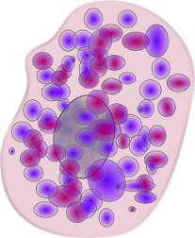
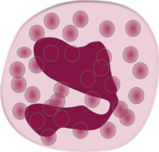
Biphasic Anaphylaxis
Treatment
Treatment
Symptom Score
8 to 12 hours¹
Antigen Exposure
First Phase
Asymptomatic
Second Phase
Classic Model
30 minutes to 72 hours²
Time
New Evidence
1. Lieberman P. J Allergy Clin Immunol. 2005;115:S483-S523.
2. Lieberman P. Allergy Clin Immunol Int. 2004;16(6):241-248.
Notes:
58
In biphasic reactions, the initial symptoms resolve spontaneously or with treatment within hours (similar to a uniphasic response). Subsequent to resolution there is an asymptomatic period which can last several hours.
Lieberman P. Biphasic anaphylaxis. Allergy Clin Immunol Int. J World Allergy Org. 2004;16(6):241-248.
Lieberman P, Kemp SF, Oppenheimer J, Lang DM, Bernstein IL, Nicklas RA. The diagnosis and management of anaphylaxis: an updated practice parameter. J Allergy Clin Immunol. 2005;115:S483-523.

Slide 59
Protracted Anaphylaxis
Initial Symptoms
0
Time
Antigen Exposure
Up to 32 hours¹
1. Lieberman P, et al. J Allergy Clin Immunol. 2005;115:S483-S523.
Notes:
Protracted anaphylactic reactions:
Are frequently associated with profound hypotension
May last longer than 24 hours
Are minimally responsive to aggressive therapy
Are associated with a poor prognosis (Stark, 1986)
Lieberman P, Kemp SF, Oppenheimer J, Lang DM, Bernstein IL, Nicklas RA. The diagnosis and management of anaphylaxis: an updated practice parameter. J Allergy Clin Immunol. 2005;115:S483-523.

Slide 60
Practice Parameter Summary: Clinical Impact of Biphasic Response
Predictors of biphasic reactions:
History of prior anaphylaxis
Unknown precipitant
Patients who present with symptoms of diarrhea or wheezing
A second dose can be administered within 5 minutes of the previous dose
There is no way to predict who will require ≥2 doses based on the severity of previous events alone
Lieberman P, et al. J Allergy Clin Immunol. 2010;126:477-480.
Rudders SA, et al. Pediatrics. 2010;125:e711-e718.
Lee S, et al. JACI In Practice. 2014;2(3):281-287.
Wood RA, et al. JACI. 2014;133:461-7

Slide 61
Protocol:
Place the patient on the back (or in a position of comfort if there is respiratory distress and/or vomiting.
Elevate the lower extremities.
Administer adrenaline*
Assess circulation, airway, breathing, and mental status, skin, and other visual indicators.
Adrenaline
Intramuscularly administered-adrenaline (epinephrine) is life-saving for the treatment of anaphylaxis.
It relieves the symptoms of anaphylaxis including preventing, and relieving, airway obstruction via Beta-2 adrenergic effects caused by mucosal edema and smooth muscle concentration.
It prevents and relieves fall in blood pressure and shock.

Slide 62
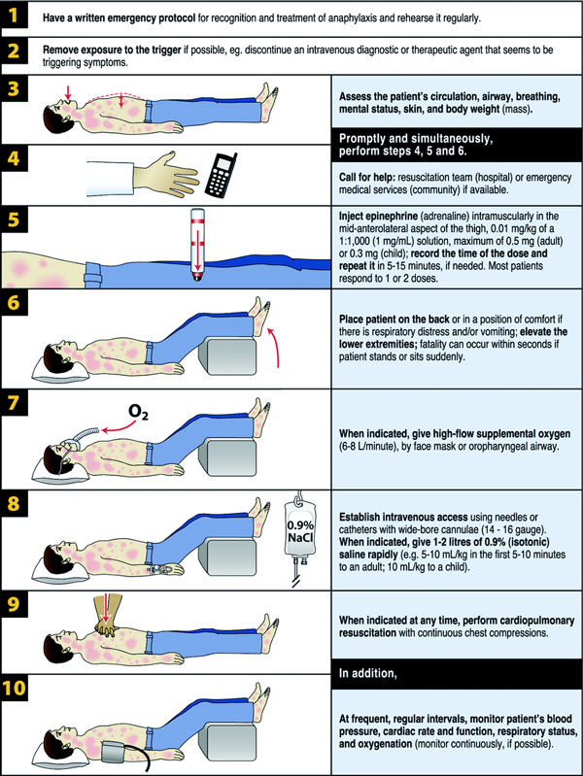
Basic management of anaphylaxis

Slide 63
Prevention:
It is important to advise patients about the need to have as-advised regular follow-up visits with a physician, preferably an allergy/immunology specialist, to:
confirm their specific trigger(s) of anaphylaxis
prevent recurrences by avoiding the specific trigger(s)
have an emergency action plan and emergency medication on hand
have support from the family members
receive immunomodulation, where it is clinically approved and relevant
Immunomodulation
Immunomodulation is Immunotherapy with Hymenoptera venoms or fire ant extracts which are effective therapies to reduce the risk of anaphylaxis.

Slide 64
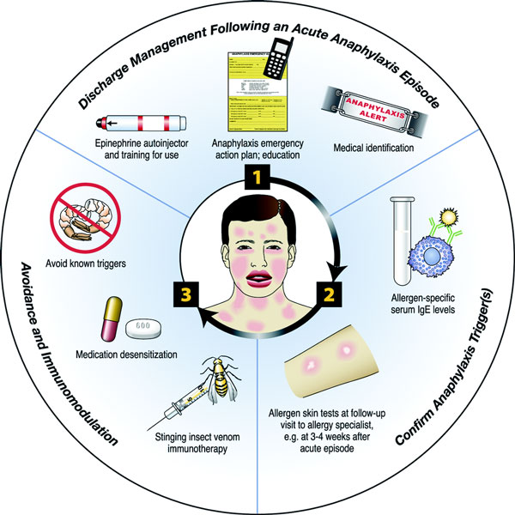

Slide 65
Patient Education and Management Following an Anaphylactic Event

Slide 66
Discussion Question
After you acutely manage a patient with anaphylaxis or see them on follow-up, how do you manage prevention and preparedness for future events?
Patient education?
Provide auto-injectors?
Emergency action plan?

Slide 67
Universal Recommendations for Patients at Risk for Anaphylaxis
Across available guidelines:
Epinephrine auto-injector (2 doses)
Auto-injector training
Education on avoidance of allergen
Follow-up with primary care physician
Referral to allergist if first presentation or cause is unknown
Monitor auto-injector expiration dates
Block auto-injector substitution at pharmacy
Emergency action plan
Burks AW, et al. J Allergy Clin Immunol. 2012;129:906-920.
Simons FER, et al. WAO Journal. 2011;4:13-37.
Boyce JA, et al. J Allergy Clin Immunol. 2010;126:S1-S58.
Lieberman P, et al. J Allergy Clin Immunol. 2010;126:477-480.
Soar J, et al. Resuscitation. 2008;77:157-169.

Slide 68
Patient Plans for Future Anaphylaxis Management
Wood RA, et al. J Allergy Clin Immunol. 2014;133:461-467.

Slide 69
Emergency Action Plans
Emergency action plans should be developed for all patients with anaphylaxis
The following steps should be included:
Do not hesitate to give epinephrine
Inject epinephrine in thigh
IMPORTANT: Asthma inhalers and/or antihistamines cannot be depended on in anaphylaxis
Call 911 or rescue squad
Call emergency contacts
American Academy of Allergy, Asthma & Immunology. Anaphylaxis Emergency Action Plan. Available at: http://www.aaaai.org/members/resources/anaphylaxis_toolkit/action_plan.pdf.

Slide 70
Reasons Patients Report Why They Did Not Use an Auto-injector
Not prescribed by physician
Not affordable/not filled
Not accessible when reaction occurred
Previous reaction improved quickly
Current reaction seemed mild or improved quickly
Used another medication to treat episode
Patient taking another medication that interfered
Didn’t want to go to ED
Patient was unsure when to inject or injected too late
Rapid progression of reaction
Simons KJ, Simons FER. Curr Opin Allergy Clin Immunol. 2010;10:354-361. Simons FER, et al. J Allergy Clin Immunol. 2009;124:301-306.
Notes:
70
70

Slide 71
Additional Considerations: ED and Hospital-based Management

Slide 72
Discussion Questions
Are other diagnostic tests warranted in the ED or hospital setting?

Slide 73
Plasma Histamine and Tryptase Levels Following Bee Sting Challenge
80
40
0
60
30
0
Tryptase (ng/mL)
Histamine (ng/mL)
0 2 4
Time After Sting (hours)
Schwartz LB, et al. J Clin Invest. 1989;83:1551-1555.

Slide 74
Tryptase and Histamine Dynamics
Tryptase levels provide a more precise measure of involvement of mast cells than clinical presentation¹
Total serum tryptase may remain elevated acutely for 6+ hours²
Peaks at 1 hour: obtain blood sample within 3 hours
Normal serum tryptase value is <10 ng/mL; the higher the value, the higher the sensitivity³
Positive predictive value of serum tryptase can be 92.6%³
Negative predictive value is only 52%
Plasma histamine begins to rise within 5 minutes but remains elevated for 30 to 60 minutes⁴
Because of longer half-life, serum tryptase is preferred
Schwartz LB, et al. Immunol Clin North Am. 2006;26:451-463. 2. Lieberman P, et al. J Allergy Clin Immunol. 2010;126:477-480. 3. Tanus T, et al. Ann Emerg Med. 1994; 24:104-107. 4. Laroche D, et al. Anesthesiology. 1991;75:945-949.

Slide 75
Ancillary Treatments: Second Line to Epinephrine
Ranitidine: 50 mg in adults and 12.5 to 50 mg (1 mg/kg) in children diluted in 5% dextrose to a total volume of 20 mL and injected IV over 5 minutes
Cimetidine: (4 mg/kg) may be administered IV to adults, dose not established for children
Nebulized albuterol: 2.5 to 5 mg in 3 mL normal saline
Methylprednisolone: 1 to 2 mg/kg per 24 hours
Lieberman P, et al. J Allergy Clin Immunol. 2010;126:477-480.

Slide 76
Ancillary Treatments: For Refractory Hypotension
Dopamine: 400 mg in 500 mL normal saline IV 2 to 20 μg/kg/min
Glucagon: 1 to 5 mg (20-30 μg/kg, max 1 mg in children), IV over 5 minutes followed with continuous IV infusion 5 to 15 μg/min

Slide 77
Discussion Questions
For patients who do not respond to IM epinephrine or are in apparent shock, do you consider IV epinephrine?
If so, are you familiar with appropriate dosing?

Slide 78
IV Epinephrine
If repeated IM doses are needed, patient may benefit from IV dosing
Ensure patient is monitored:
Continuous ECG and pulse oximetry and blood pressure
Children:
IM adrenaline is the preferred route for children
IV route is recommended only in specialist pediatric settings by those familiar with use
ONLY if patient is monitored and IV access is already available
No evidence on which to base a dose recommendation
ECG, electrocardiogram.

Slide 79
IV Epinephrine Dosing in Adults
Adrenaline IV bolus dose
Titrate IV adrenaline using 50 mcg boluses according to response
The prefilled 10-mL syringe of 1:10,000 adrenaline contains 100 mcg/mL
A dose of 50 mcg is 0.5 mL, which is the smallest dose that can be given accurately
Do not give the undiluted 1:1,000 adrenaline concentration IV

Slide 80
Summary
Anaphylaxis is a life-threatening systemic reaction with rapid onset
Anaphylaxis is increasing in all countries
In children, foods are the most common cause anaphylaxis
Early recognition is essential to optimal anaphylaxis management
IM epinephrine is the treatment of choice for anaphylaxis
Epinephrine should be administered immediately at the onset of likely anaphylaxis
Some reactions may be protracted or biphasic and warrant additional consideration and monitoring
Emergency action plans should be developed for all patients at risk for anaphylaxis
Education on anaphylaxis and allergen avoidance is critical for patients and their caregivers

Slide 81
Delayed Anaphylaxis to Alpha-gal
Triggered by an IgE antibody to a sugar (not a protein) Galactose alpha 1-3 galactose (“alpha gal”) found in meat (beef, pork, lamb, venison, bison but not poultry or fish)
Gelatin and Cetuximab also contain alpha-gal
Can occur 3 to 6 hours after ingestion
May be severe/ life threatening:
Skin (itch, urticaria, angioedema)
GI symptoms (cramping, diarrhea, nausea)
Respiratory symptoms (cough, wheeze, dyspnea)
Cardiovascular symptoms (arrhythmia, blood pressure fall, syncope, shock) – Death
Can develop in adulthood
May be result of the bite of a Lonestar tick or a “seed tick” (larva form of species of ticks as deer ticks or dog ticks)
Skin tests (+) to fresh meat but not to commercial extracts

Slide 82
Lonestar Tick

Slide 83
Clinical Characteristics of Alpha-Gal Allergy
Delayed onset generalized urticaria or anaphylaxis starting 3-6 hours after eating beef, pork, or lamb
Some also have reactions to milk (contains alpha-gal)
Children are more likely to have urticaria than anaphylaxis
In cases of new onset cow's milk allergy in children >5 years old, alpha-gal should be considered as an alternative diagnosis to protein-based milk allergy
May not occur on each ingestion
Reaction related to quantity of meat ingested
Therefore consider complete elimination of meat or allowing continued ingestion of quantities previously tolerated 2-3 times a week

Slide 84
Mast Cell Activation Syndrome (MCAS)
Classification
Primary MCAS
KIT-mutated, clonal mast cells are detected
Secondary MCAS
Underlying inflammatory disease, often in the form of an IgE-dependent allergy, but no KIT-mutated mast cells, is found
Idiopathic MCAS
Neither an allergy or other underlying disease, nor KIT-mutated mast cells are detectable
Valent P. Allergy. 2013;68(4):417-424.

Slide 85
Criteria for Diagnosis MCAS
Typical symptoms
Acute urticaria, flushing, pruritus, headache, abdominal cramping, diarrhea, vomiting, respiratory symptoms and hypotension
Substantial transient increase in mast cell mediators (ST increase 20% + 2 ng/mL) within 4 hours of a reaction
Tryptase, histamine, leukotriene C₄, or PGD₂
A response to agents attenuating the production or activities of these mediators
Valent P, et al. Int Arch Allergy Immunol. 2012;157(3):215-225.

Slide 86
Features Predictive of Clonal Mastocytosis
Male sex
Presyncopal or syncopal episodes in the absence of urticaria or angioedema
Higher frequency of CV problems and insect related episodes and higher baseline tryptase levels in the clonal group
Alvarez-Twose I, et al. J Allergy Clin Immunol. 2010;125(6):1269-1278.

Slide 87
Patients Receiving Antihypertensive Medications
β-blocker, ACE-inhibitor, diuretic, or antihypertensive medication use in aggregate was associated with increased organ system involvement and hospital admission in ED patients with anaphylaxis¹
However, there is no contraindication for the use of epinephrine with this class of medications and should be given in an emergency to treat life-threatening allergic reactions²
1. Lee S, et al. J Allergy Clin Immunol. 2013;131:1103-1108.
2. Lieberman P, et al. J Allergy Clin Immunol. 2010;126:477-480.

Slide 88
Risk of Systemic Reactions in Patients Taking β-blockers Receiving Immunotherapy
It is unclear whether patients taking β-adrenergic blocking agents are at increased risk of having a serious systemic reaction to allergen immunotherapy injections
In one study, β-blockers did not increase the frequency of systemic reactions in patients who were receiving immunotherapy (P >.95)
Patients taking β-blockers may still be at increased risk, however, from more severe systemic reactions or their reactions may be more refractory to therapy
Anaphylaxis in patients taking β-adrenergic blocking agents may be more difficult to treat
The “contraindication should be relative not absolute”
Lieberman P, et al. J Allergy Clin Immunol. 2010;126:477-480. Hepner MJ, et al. J Allergy Clin Immunol. 1990;86(3 Pt 1):407-411. Müller UR, Haeberli G. J Allergy Clin Immunol. 2005;115:606-610.

Slide 89
Considerations for a Differential Diagnosis
Vasovagal reactions
Flush syndrome (carcinoid, postmenopausal, autonomic epilepsy)
Non-IgE mediated food reactions
Restaurant syndromes (scombroidosis)
Mastocytosis and other conditions with excessive histamine release
Hereditary angioedema
Red man syndrome (vancomycin)
Other shock (hemorrhage, sepsis)
Panic or Munchausen
Patient feeling like they are going to die
Cianferoni A, Muraro A. Immunol Allergy Clin North Am. 2012;32:165-195.
Notes:
89
89

Slide 90
The World Allergy Organization is an international alliance of 95 regional and national allergy, asthma and immunology societies. Through collaboration with its Member Societies WAO provides a wide range of educational and outreach programs, symposia and lectureships to allergists/immunologists around the world and conducts initiatives related to clinical practice, service provision, and physical training in order to better understand and address the challenges facing allergists/immunologists worldwide.
www.worldallergy.org

